Slide 1
Software engineering in the wild – what makes awesome engineering ?

Slide 2


Intros
What we will build
Live example
Circuit breaker test
FRAMEWORKS
Reliability
engineering

Slide 3
Intros
What we will build
Live example
Circuit breaker test
URI uri = URI.create(bookstoreServer + "/recommended");
this.restTemplate.getForObject(uri, String.class)
Front End
Reading Application
REQUEST
Back End
Spring Boot ReST Server
(Book Store Service)
Retrieve list of books
to read
RESPONSE
Excited user uses
your app
Meanwhile, in the depths of the internet,
so much can go wrong…
Service failure
Latency
Cloud provider
…which all means an
unhappy customer

Slide 4

Intros
What we will build
Live example
Circuit breaker test
“I spend a lot of time thinking about how to break Netflix”
Site Reliability Engineer at Netflix

Slide 5

Intros
What we will build
Live example
Circuit breaker test
Monitoring & Alerting
AWS Region 1
Stateless Reading Application
Hystrix
(Circuit Breaker)
REQUEST
Spring Gateway
(API)
Stateless Book Store Application
RESPONSE
Eureka
(Service Discovery)
FIND
REGISTER
Eureka
(Service Discovery)
AWS Region 2
REGISTER
FIND
Stateless Reading Application
Hystrix
(Circuit Breaker)
REQUEST
Spring Gateway
(API)
Stateless Book Store Application
RESPONSE
KEY
Original Stateless services (from last slide)
Instances of services
Resiliency patterns
Simian Army

Slide 6

Intros
What we will build
Live example
Circuit breaker test
Spring Boot ReST Client
(Stateless Reading Application)
Hystrix
(Circuit Breaker)
REQUEST
Spring Boot ReST Server
(Stateless Book Store Application)
Circuit breakers maximise uptime if a service fails through fallback methods and fast failure – at least you are not sat waiting !
RESPONSE
How a circuit breaker works
fallback
fast failure
success
CLOSED
OPEN
HALF OPEN
open on failure of
rest server
check if rest server
working again
If fails stay open
If success close

Slide 7
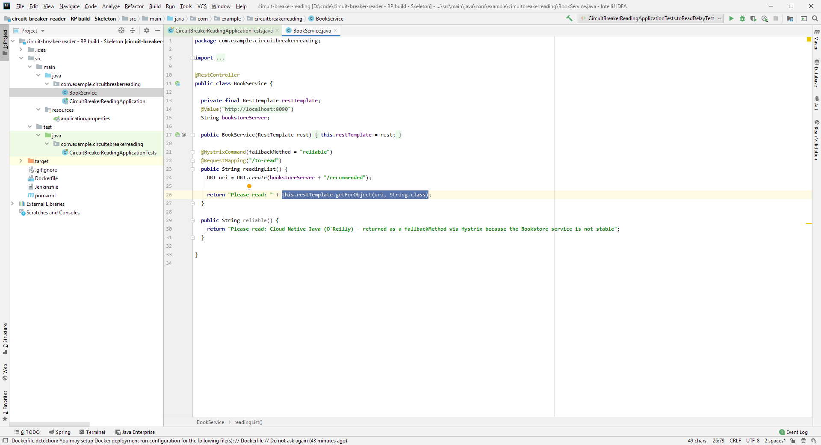
Intros
What we will build
Live example
Circuit breaker test

Slide 8
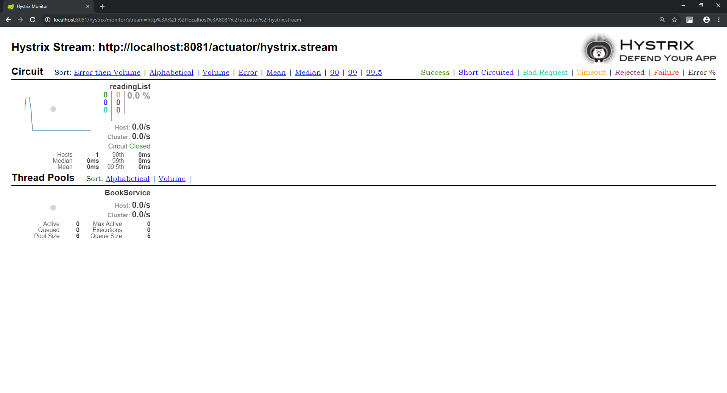
Intros
What we will build
Live example
Circuit breaker test

